Slide 1

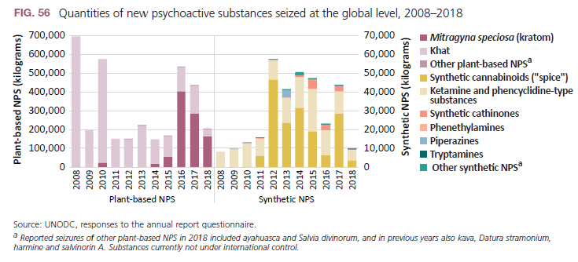
Seizures of both plant NPS based and synthetic NPS declined in 2018

Slide 2
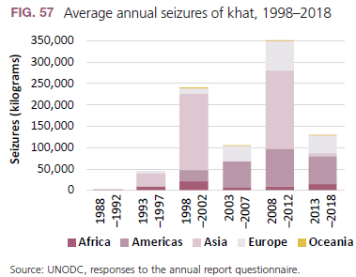
New Psychoactive Substances
Global seizures of khat, fluctuating strongly year on year, declined over the period 2013-2018 as compared to the period 2008-2012, notably reflecting less quantities reported seized in Asia.

Slide 3
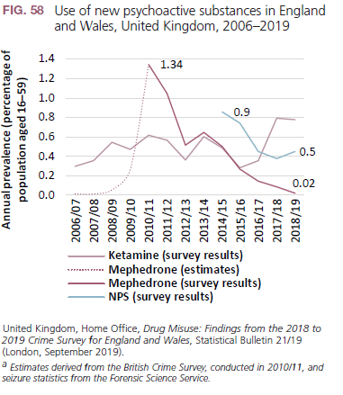
New Psychoactive Substances
Following the introduction of legislation on mephedrone in 2010, mephedrone use declined and following NPS legislation in 2016, use of NPS declined. Ketamine use, however, increased in recent years.

Slide 4
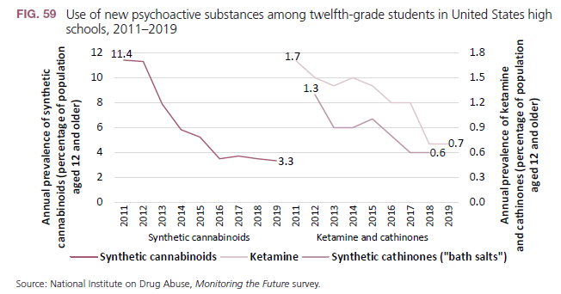
New Psychoactive Substances
Following the introduction of several waves of controls of NPS over the 2010-2012 period, use of NPS declined.

Slide 5
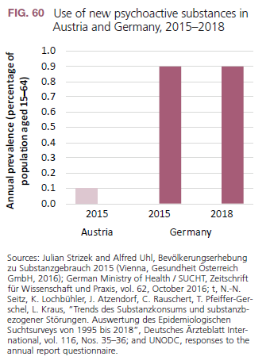
New Psychoactive Substances
Following the introduction on NPS legislation, in Austria (2008 and 2012) use of NPS remained low in Austria.
NPS use appears to have increased in Germany for several years; once NPS legislation was introduced in 2016, NPS use stopped growing.

Slide 6
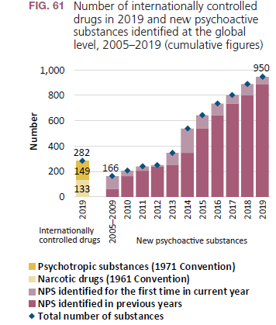

New Psychoactive Substances
Despite of ongoing scheduling, there are three times as many identified NPS than there are psychoactive substances under international control.

Slide 7
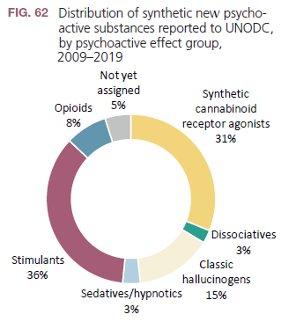
New Psychoactive Substances
Most identified NPS are stimulants (synthetic cathinones and phenetylamines), followed by synthetic cannabinoids (“spice” products). Most of the identified opioids have been fentanyl analogues.

Slide 8
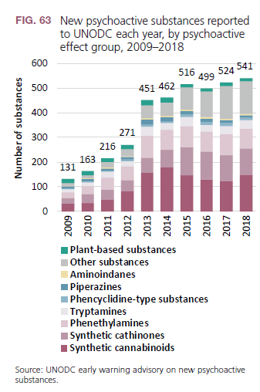
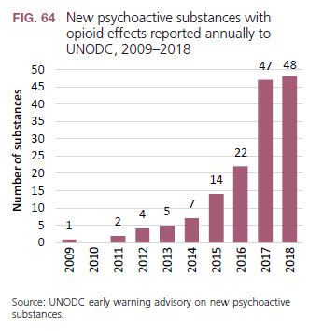
New Psychoactive Substances
Overall number of identified NPS by Member States has begun to stabilize after 2015 while NPS with opioid effects have been still growing strongly until 2017 before showing first signs of stabilisation.

