Slide 1


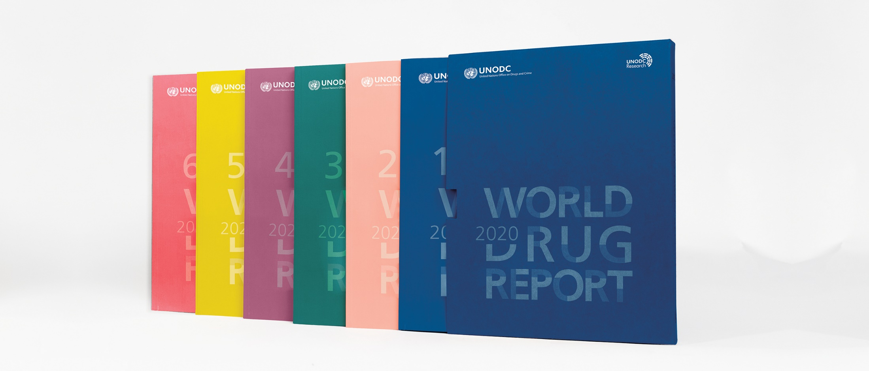
World Drug Report 2020: Drug use and health consequences
25 June 2020

Slide 2
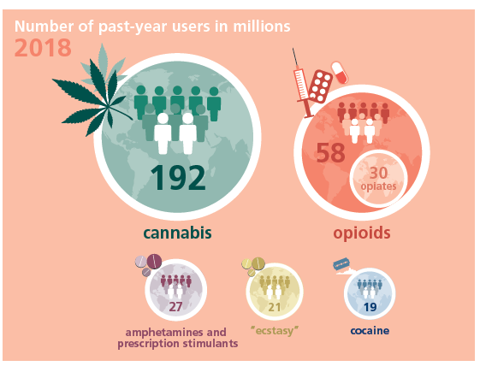
Global numbers of people using drugs 2018

Slide 3
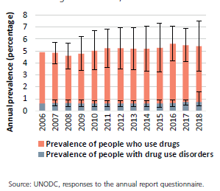
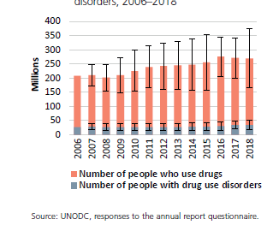
Drug use has been on the rise - both overall numbers and the proportion of the world’s population
Increased far more rapidly in developing countries though more widespread in developed countries
Number of people who use drugs and people with drug use disorders, 2006–2018
Prevalence of drug use and drug use disorders, 2006–2018

Slide 4
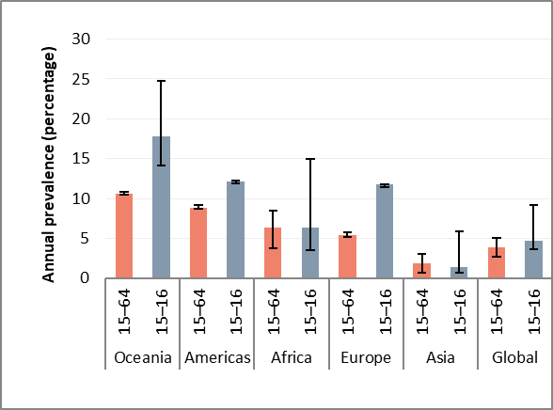
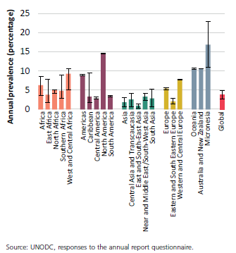
Global and regional use of cannabis
Use of cannabis among people aged 15–16, and general population aged 15–64, 2018
Use of cannabis among general
population aged 15–64, 2018
Source: UNODC, responses to the annual report questionnaire; and other government reports.
Note: The estimates of the annual prevalence of use among those aged 15–16 are based on school surveys in most countries and may not be representative of all those.

Slide 5
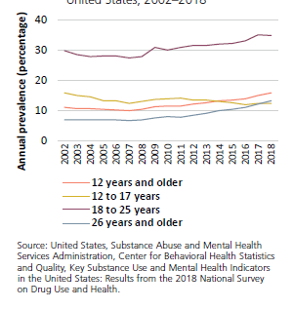
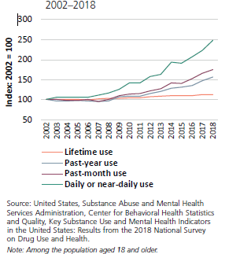
Cannabis use in the Americas has been increasing over the past decade
Trends in cannabis use, by age group,
United States, 2002–2018
Trends in cannabis use, United States,
2002–2018

Slide 6
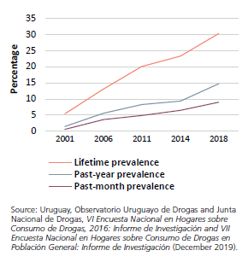
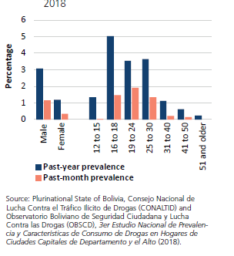
Cannabis use in South America
Cannabis use, by gender and age
group, Plurinational State of Bolivia,
2018
Trends in cannabis use, Uruguay,
2001–2018

Slide 7
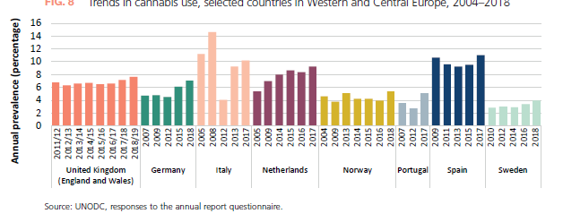
Cannabis use in Western and Central
Europe is increasing, in particular in
some countries with large populations
Trends in cannabis use, selected countries in Western and Central Europe, 2004–2018

Slide 8
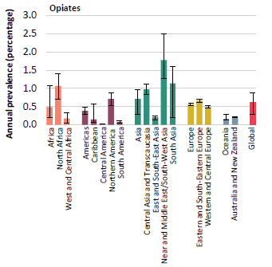
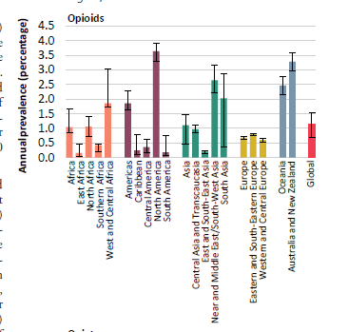
Opioids cause the greatest harm to the health of users
Use of opioids and opiates, by region and subregion, 2018
Source: UNODC, responses to the annual report questionnaire

Slide 9
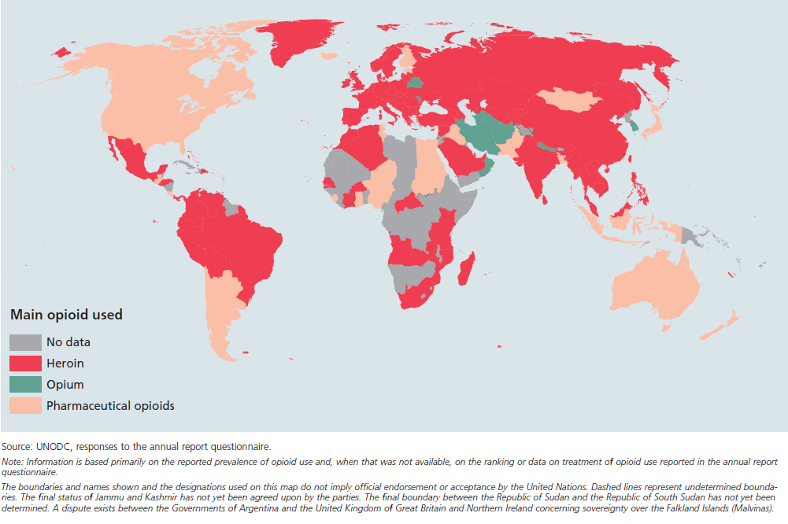
Most commonly used opioid, 2018 or latest available data

Slide 10
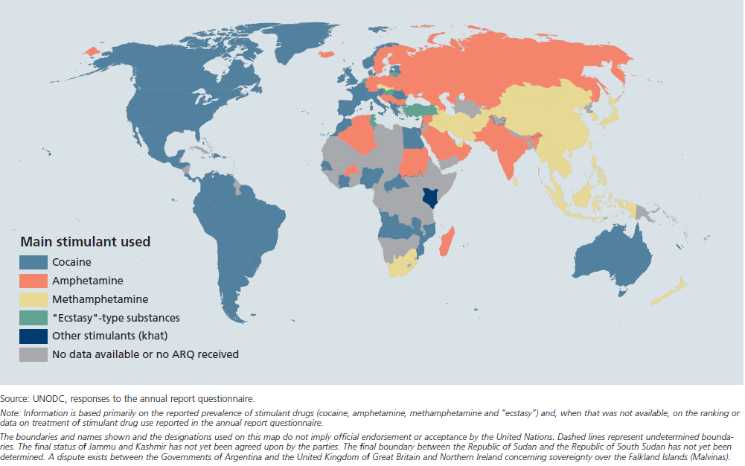
Main stimulant drug used, 2018 or latest year

Slide 11
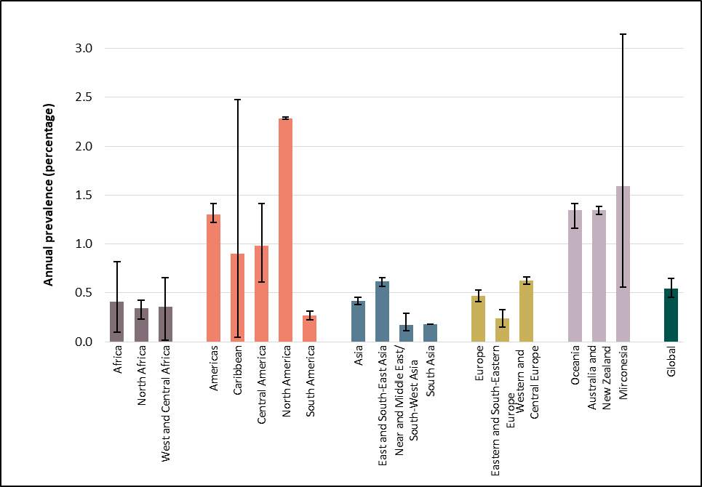
Use of amphetamines, especially methamphetamine, is increasing in parts of Asia and North America
Use of amphetamines seems to be
increasing in North America
Number of people using amphetamines
appears stable in Western and Central
Europe but the level of consumption
seems to be increasing
Methamphetamine use remains of
concern in East and South-East Asia
Wastewater analysis shows an increase
in methamphetamine use in Australia
and New Zealand
Source: UNODC, responses to the annual report questionnaire.
Note: “Amphetamines” includes the non-medical use of amphetamine, methamphetamine and pharmaceutical stimulants.

Slide 12
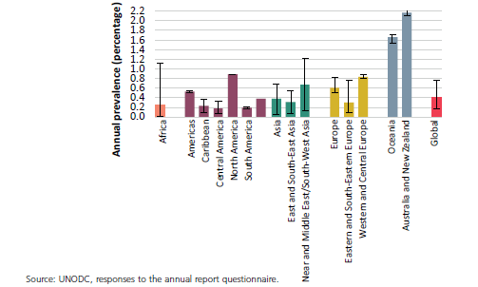
Forms of “ecstasy” have diversified, with a high MDMA content available on the main markets

Slide 13
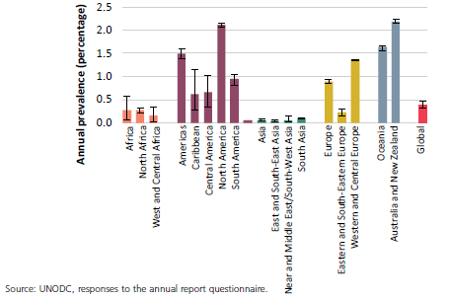
Indications of increasing cocaine use in Western and Central Europe and mixed trends in the Americas
Use of cocaine is stabilizing in
North America
Mixed trends in cocaine use in
South America
Despite a high prevalence of cocaine use, the quantities of cocaine consumed in Australia and New Zealand are small as use is sporadic

Slide 14
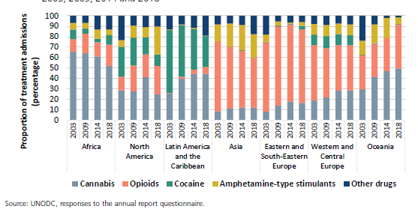
Trends in the primary drug of concern in drug treatment, by region and selected subregions,
2003, 2009, 2014 and 2018
Availability of and access to treatment services remains limited at the global level, as only one in eight people with drug use disorders receives drug treatment each year.
While one in three drug users is a woman, they continue to account for only one in five or more people in treatment.

Slide 15
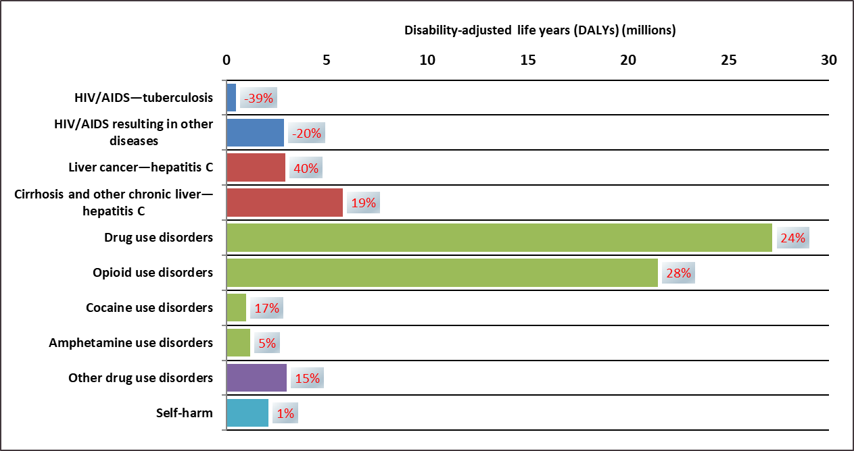
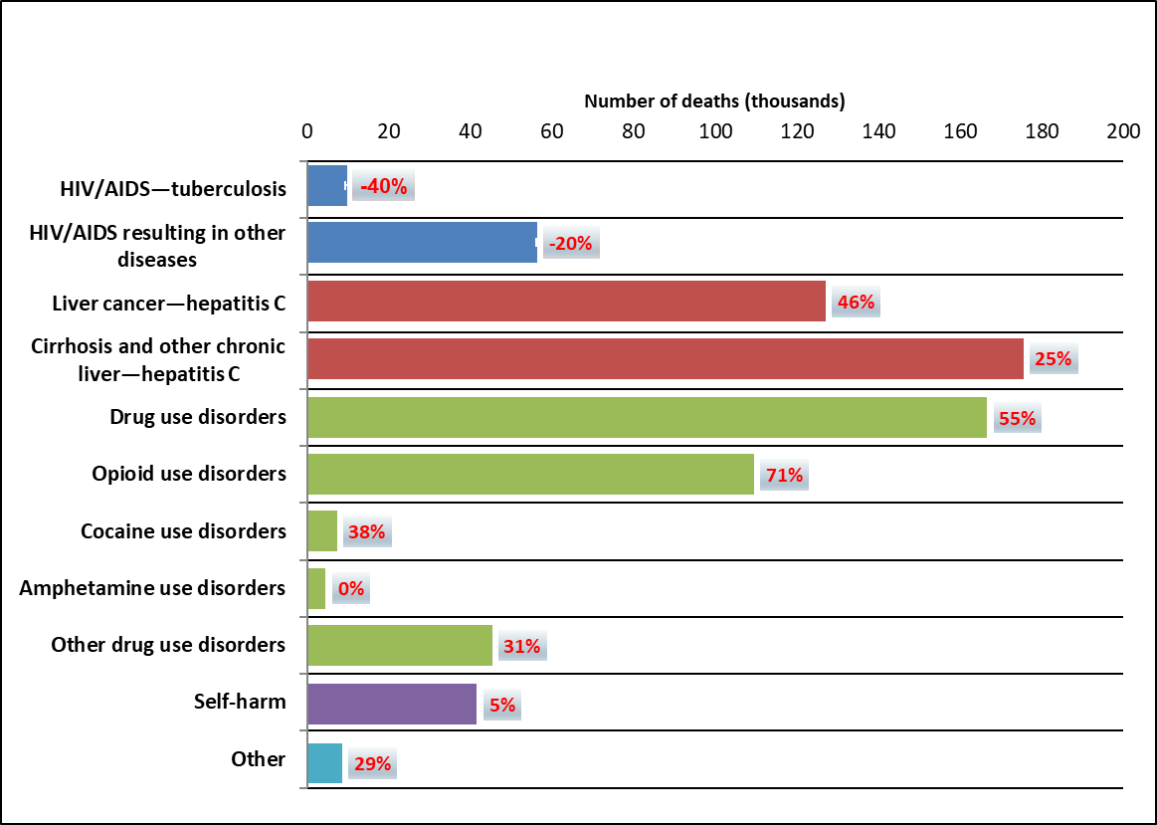
Drug use accounts for
42 million DALYs
58500 deaths
Opioids account for half of DALYs
Source: Institute for Health Metrics and Evaluation, “Global Burden of Disease Study 2017 (GBD 2017) Data Resources:
GBD Results Tools”, 2018.

Slide 16
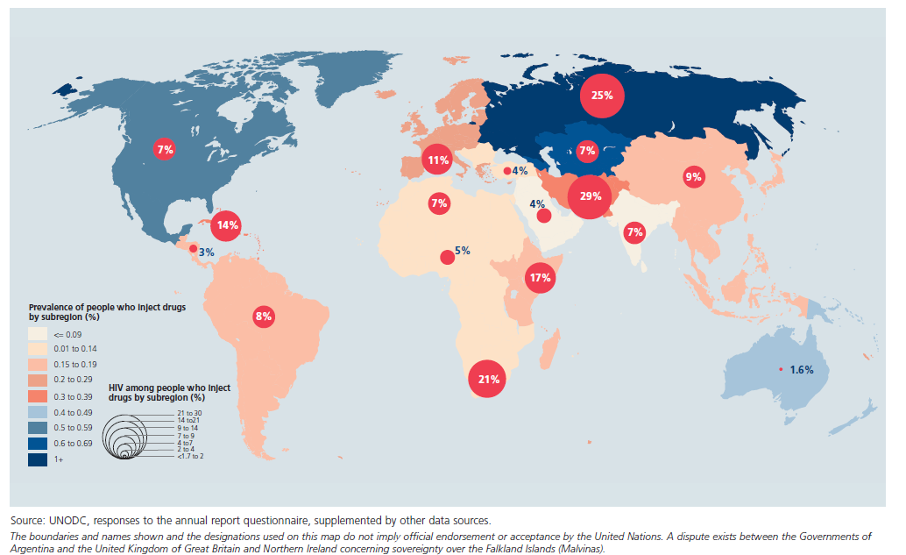
More than 11 million people inject drugs and 1.4 million living with HIV

Slide 17
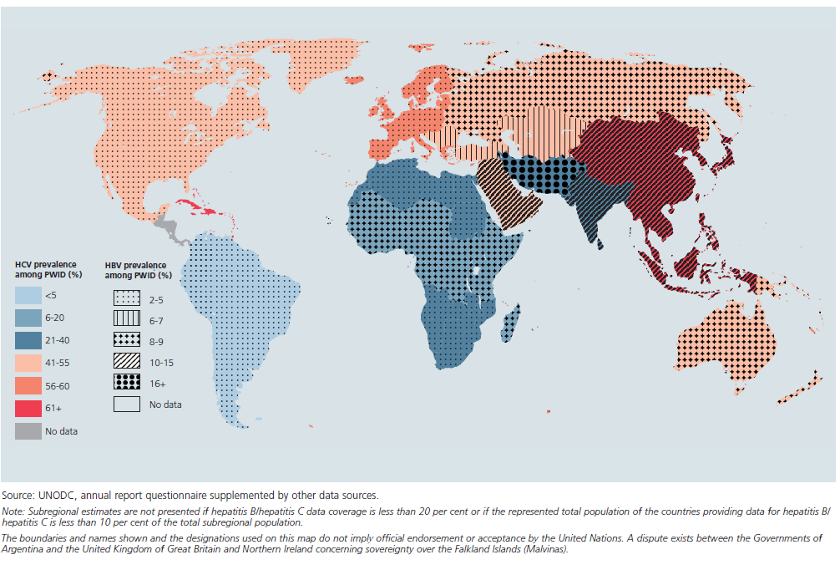
Estimated sub-regional prevalence of hepatitis C (HCV) and hepatitis B (HBV) among PWID, 2018
5.5 million PWID living with HCV
1.2 million PWID living with HIV and HCV

Slide 18
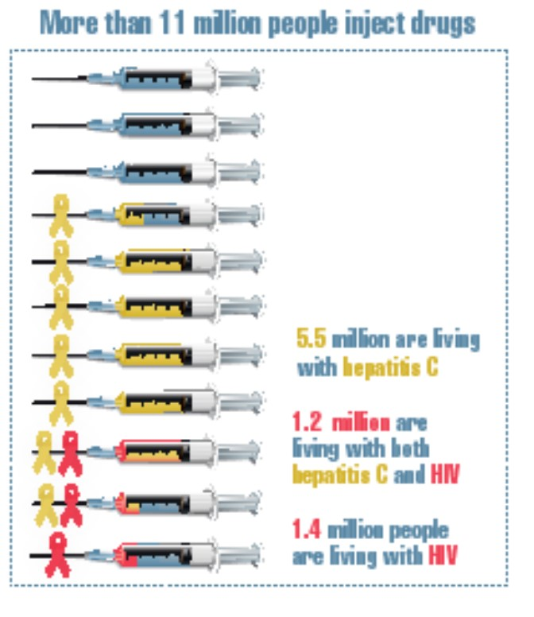
More than 11 million people inject drugs and 1.4 million living with HIV

